Slide 1
Inventory management system
Created by: Aswene SIVARAJ

Slide 2
Introduction
Project scope:
Provide an end user with an application that they can interact with using a command line interface (CLI).
User can access an inventory database containing customers, items and orders.
The user can:
create a new customer, item or order record and add it to the database,
read all customers, items and orders currently in the database,
update customer, item or order details of existing data in the database,
delete a customer, item or order from the system.
CLI benefits:
Faster than other types of user interfaces
Less memory (RAM) used compared to a GUI
Can run on other OS aside from windows
Notes:
-introduction: scope, specification, initial plans (kanabn 'before' screenshot, erd, etc. is ideal here)

Slide 3
Technologies & Concepts Applied
Technologies:
Trello – project management
Google Cloud Platform MySqL and MySqL Workbench – database
Java – programming
Java Junit – testing
Google Cloud Platform Virtual Machine – cloud server
Nexus – artifact repository
Concepts:
OOP - classes, objects, inheritance, encapsulation, polymorphism, abstraction
Constructors – initialize an object, prepare for use
Loops – execute instructions repeatedly based on a set condition
SOLID principles
Notes:
-consultant journey: what have you learned? which technologies and concepts have we looked at since day 1?

Slide 4
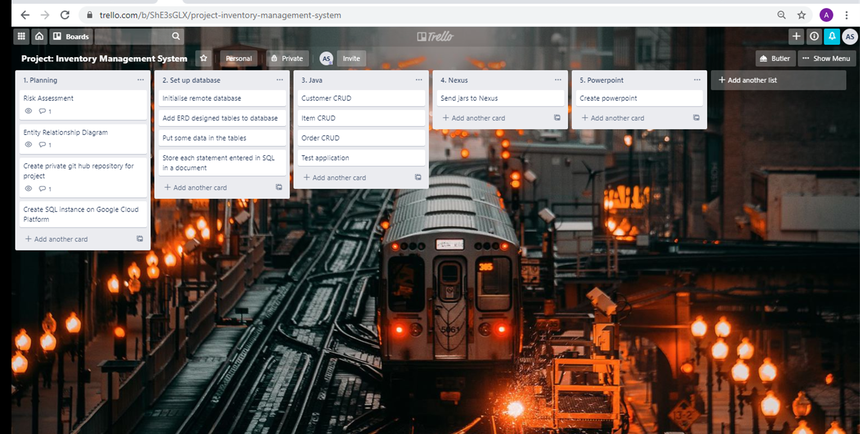
Initial Plan

Slide 5
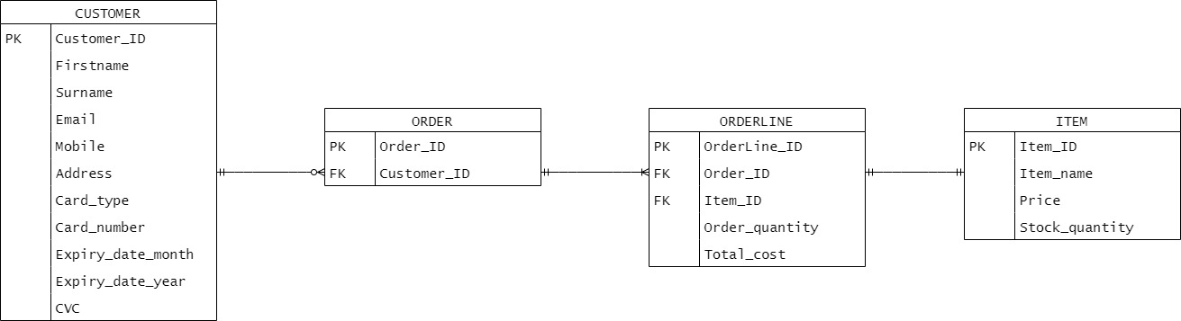
Entity Relationship diagram
Customer to order: 0-to-many
Order to orderline: 1-to-many
Orderline to item: 1-to-1
Item to orderline: 1-to-1
Orderline to order: 1-to-1
Order to customer: 1-to-1

Slide 6
DEMO
Notes:
Demo of application
http://35.197.216.43:8081/nexus/#browse/browse:maven-snapshots

Slide 7
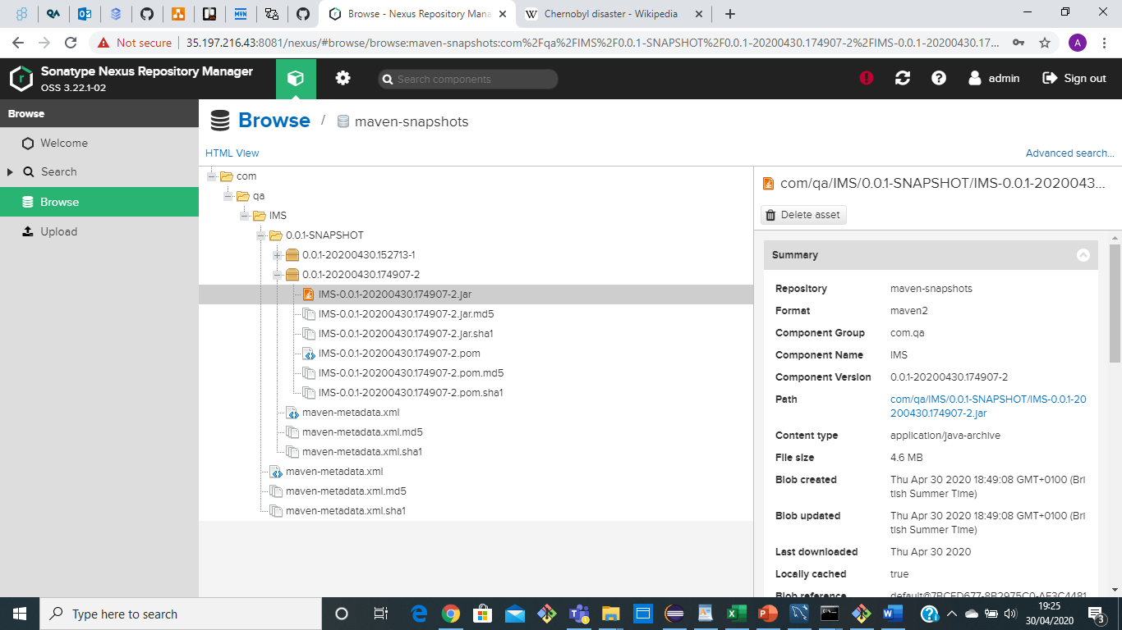
NEXUS
Notes:
-proof of nexus (screenshot of your fat .jar)

Slide 8
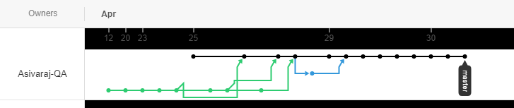
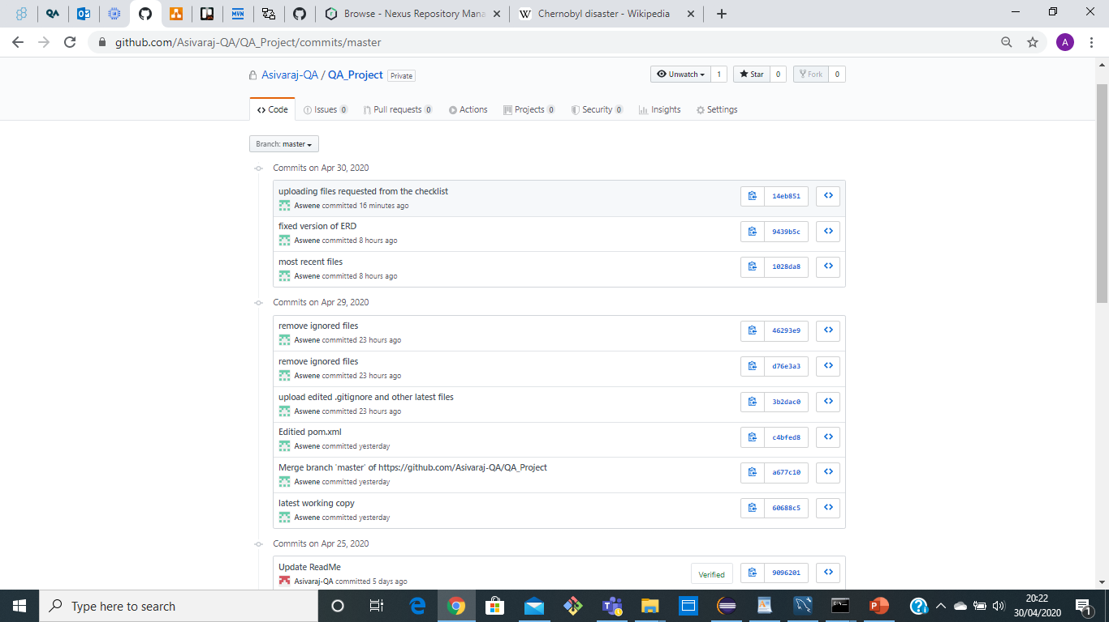
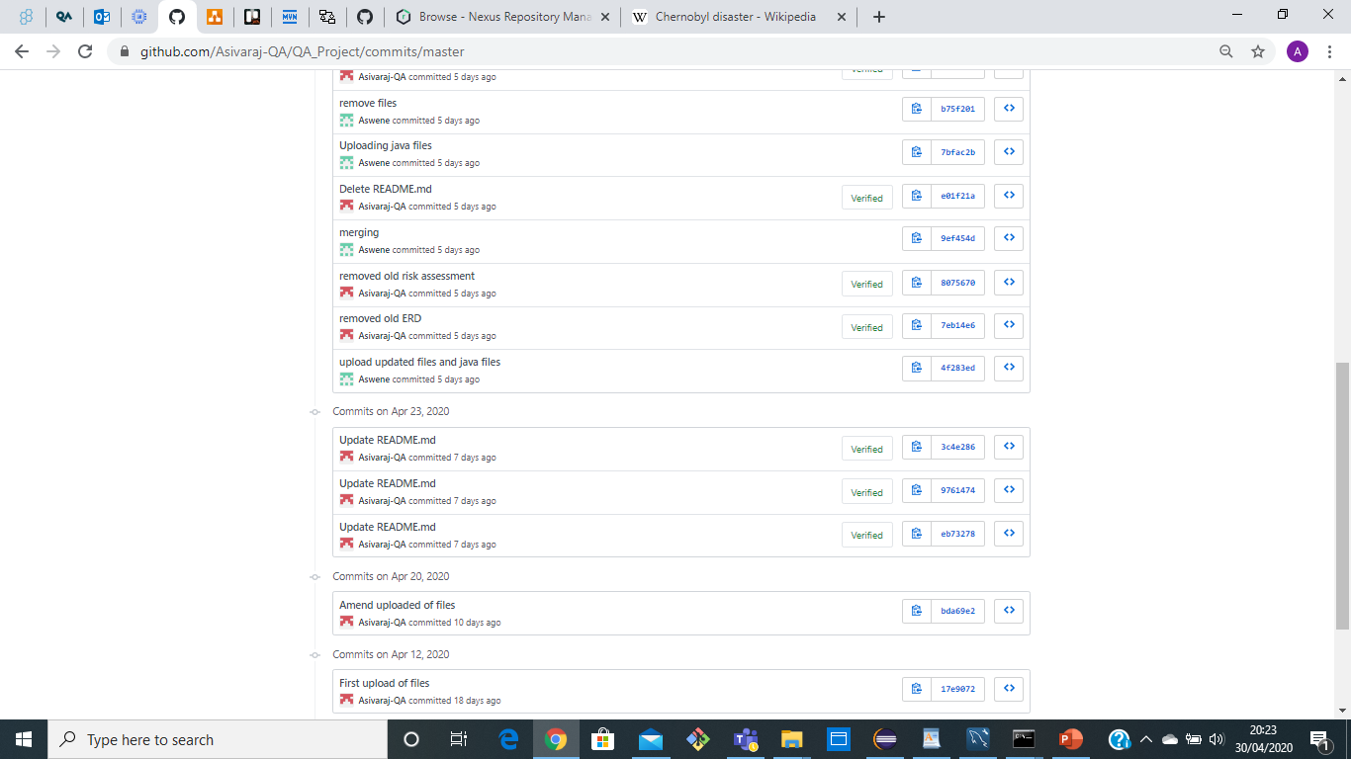
Feature-branch-model
Notes:
-proof of feature-branch model (a screenshot of your commits and/or your network is good here)

Slide 9
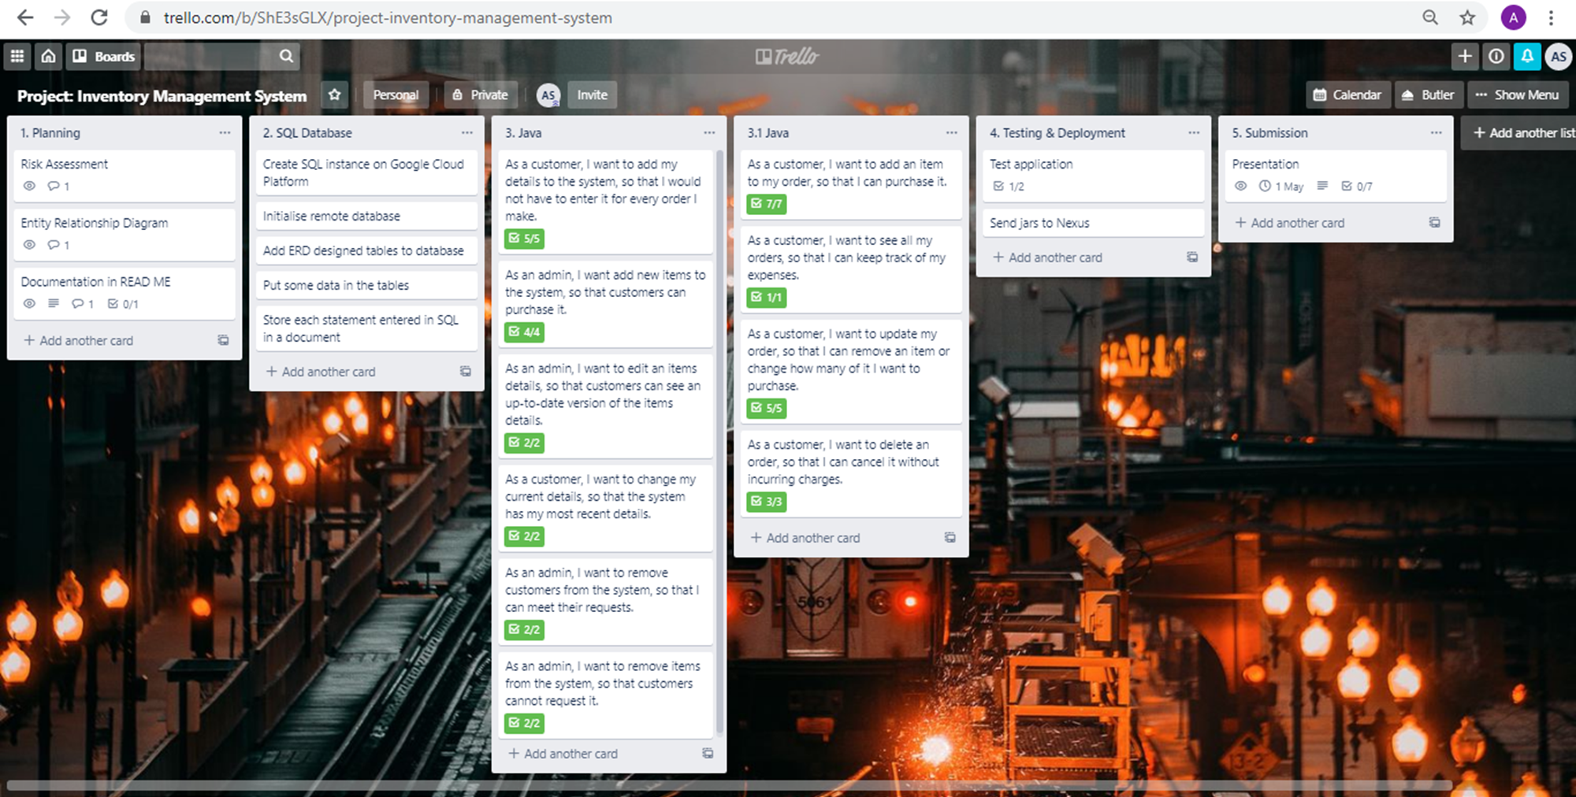
Review
Notes:
-sprint review: what did you get done? (kanban 'after' screenshot)

Slide 10
conclusion & Further work
What went well:
Current application responds to user inputs as required
Application interacts with database in the background
Weekly targets were on track
Improvements:
Split customer table into customers and payments
Application able to update stock as and when required
Further testing to improve test coverage
Improve feature branch
Improve security – user table that takes in username and password for access
Further understanding of maven and nexus
Notes:
-sprint retrospective/conclusion: what did you do well? what can you improve?

Slide 11
THANK YOU FOR LISTENING! ANY QUESTIONS?

